Slide 1
STOP All Bullies Now! (Save a life people have to live here.)
By: Cyndie Boylan.
10th grade 11-10-16

Slide 2
STOP BULLYING PEOPLE!!! You might be just jealous?

Slide 3
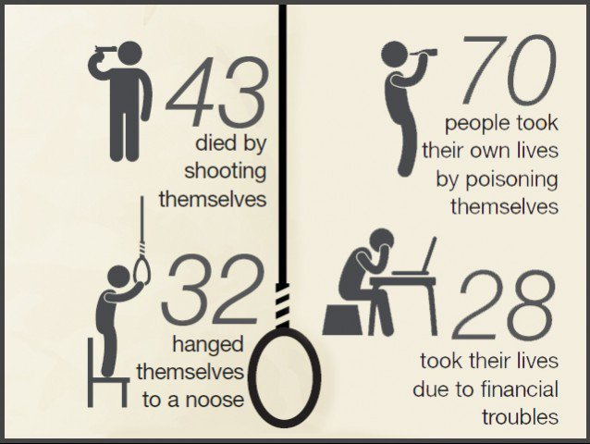
This is how many people are trying to kill themselves or trying to hurt themself cause of bullies.

Slide 4
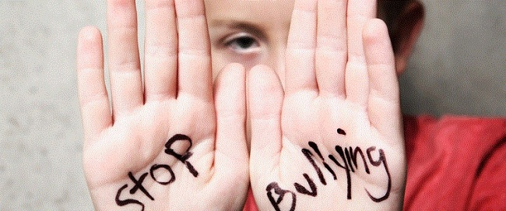
God made us the way we all are tall or short everyone is not perfect but this is a free country.

Slide 5
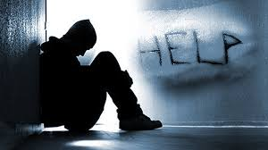
There are all kids and teenagers and adult that need help because of this bullies. People will get HURT!
Talk to an adult that you trust or
Teacher or counselor at school.

Slide 6
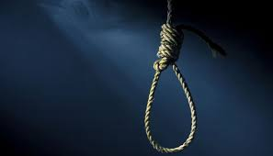
WE ALL NEED YOU HERE!
This is BAD for you NO!! We want you here and we will make this school safe for you all if you don’t think this school is safe for you or not.
Don’t even think
About this
Idea at all!
I mean it!

Slide 7
How many people commit of suicide each year.
According WHO, one million people commit suicide each year worldwide, that is about one death every 40 seconds or 3,000 per day. For each individual who takes his/her own life, at least 20 attempt to do so. Suicide has a rate of 16 per 100,000 people.

Slide 8
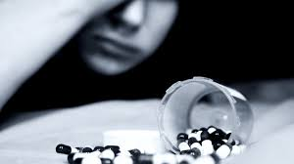
There are people do this, It’s horrible I see it in movies. Cause people think they should kill themselves because of bullies said so WELL DON’T DO IT!! DON’T LISTEN TO THEM!! It’s not good you’re ending your life because of this, of what a bully said to you.

Slide 9
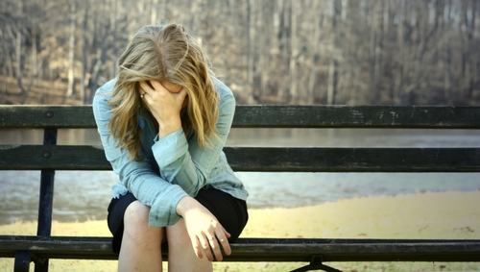
I mean it!! DON’T DO THIS!!
NO it’s bad for you it’s NOT
GOOD!!

Slide 10
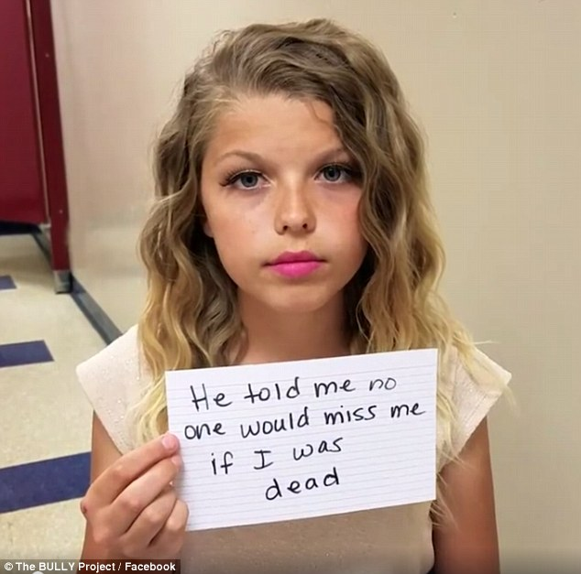
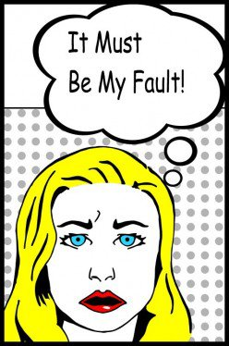

Slide 12
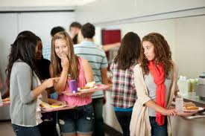
Bullies are everywhere!!
Don’t listen to them!

Slide 13
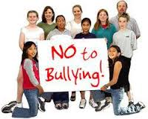

Slide 14
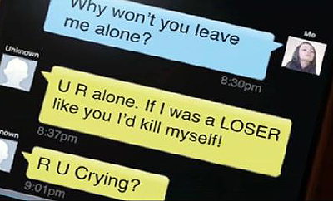
People sent mean horrible texts to them on phones.
Dont do it!
BE NICE!! To
PEOPLE!

Slide 16
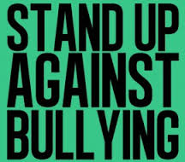
Stay strong and don't let them hurt you.
Stand up for yourself and others.
Don't show weakness.
Keep any notes you may be given by the bully to show a teacher.
Always try to have a witness.
Read more articles about how to prevent bullying.

Slide 17
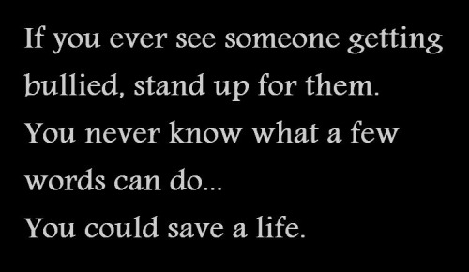
JUST BE YOURSELF!!!

Slide 19
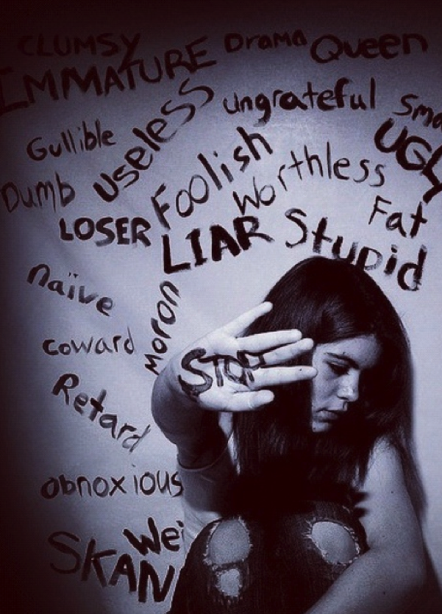

Slide 20
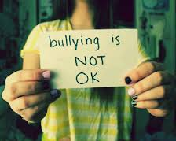
TRUE!!

Slide 21
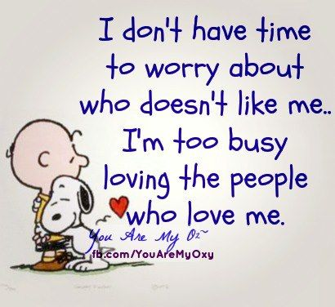
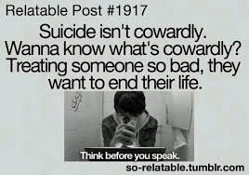

Slide 23
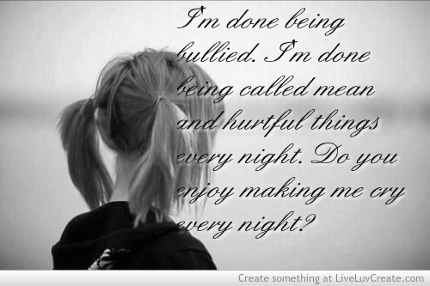
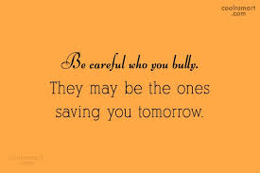

Slide 24
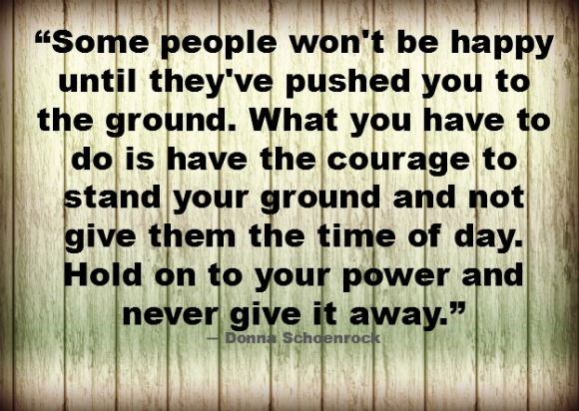
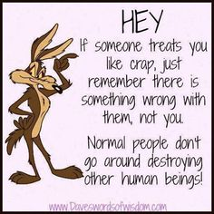

Slide 25
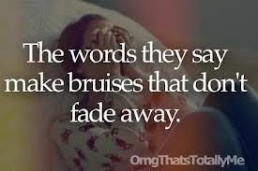
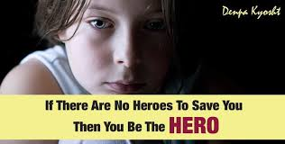

Slide 26
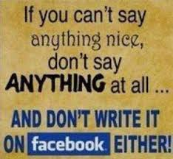
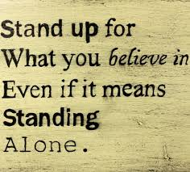
TRUE!!

Slide 27
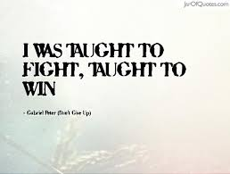
Be Strong

Slide 28
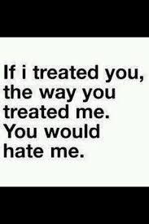
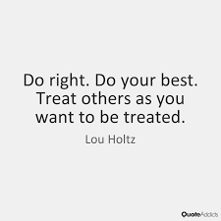

Slide 29
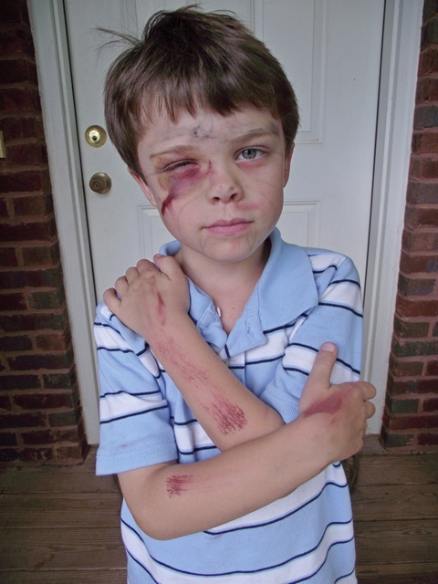
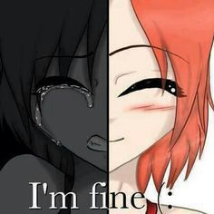
This is not good.
It’s bad he got beat
Up.
What if it was you?
NO, you’re not fine
You say that, but you’re
not.

Slide 30
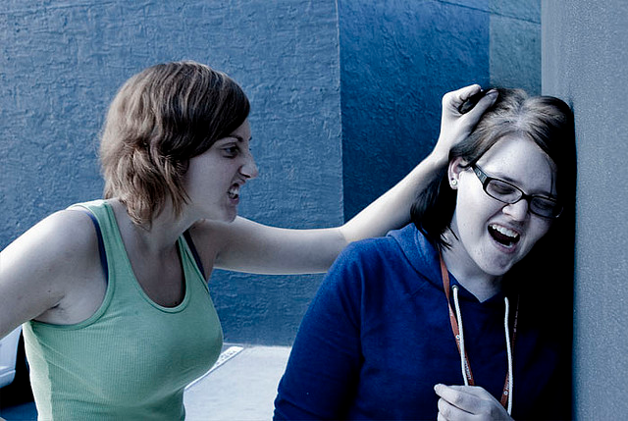
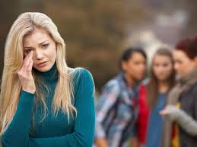

Slide 31
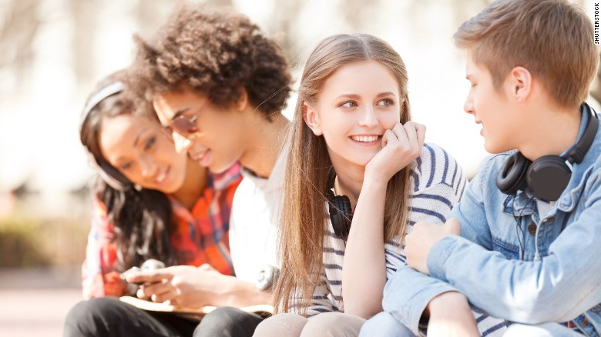
It will be OK. Talk to someone, stick with friends!

